Slide 1
Logistics Optimization for Delivery Routes
SQL data Analysis project
-submitted by-
Name:ritesh suresh redekar
course:data science batch:january 1st batch

Slide 2
Project objective:
Analyze logistics data using SQL
Identify delivery delays and inefficiencies
Improve route and warehouse performance
Generate actionable insights

Slide 3
Dataset overview:
Tables Used:
orders
routes
warehouses
deliveryagents
shipmenttracking
Tools:
MySQL Workbench

Slide 4
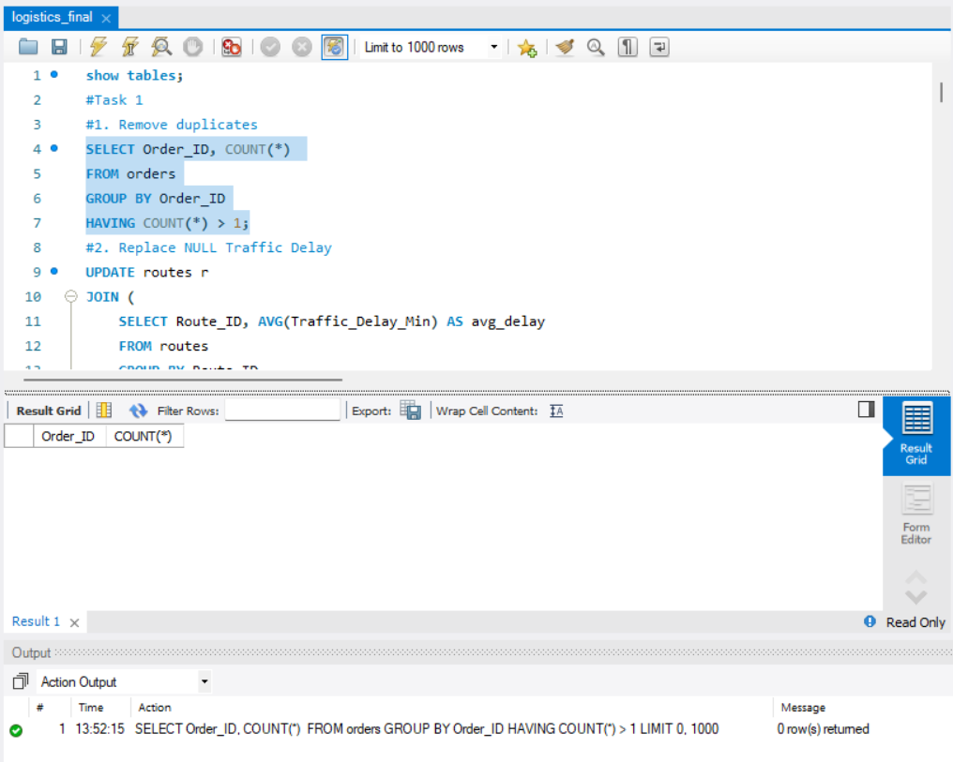
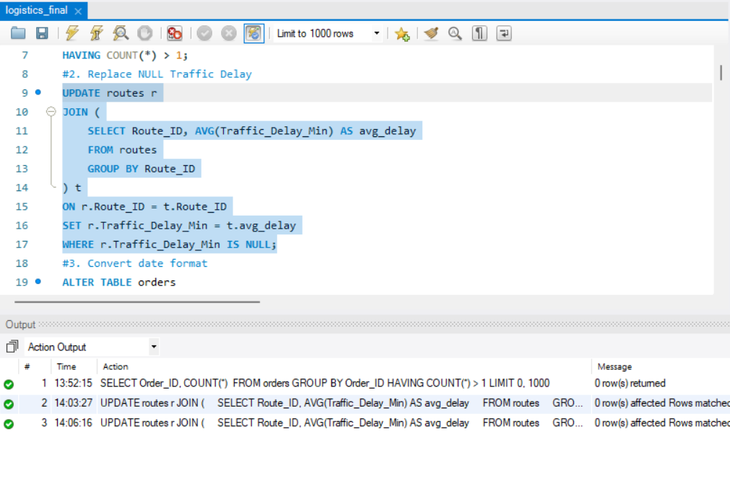
Task1:Data cleaning & preparation:
1.Remove duplicates:
• Checked duplicate Order_ID
• Verified NULL values
• Converted date formats
• Validated date consistency
2.Replace Null:
Conclusion:Data is clean and ready for Analysis.

Slide 5
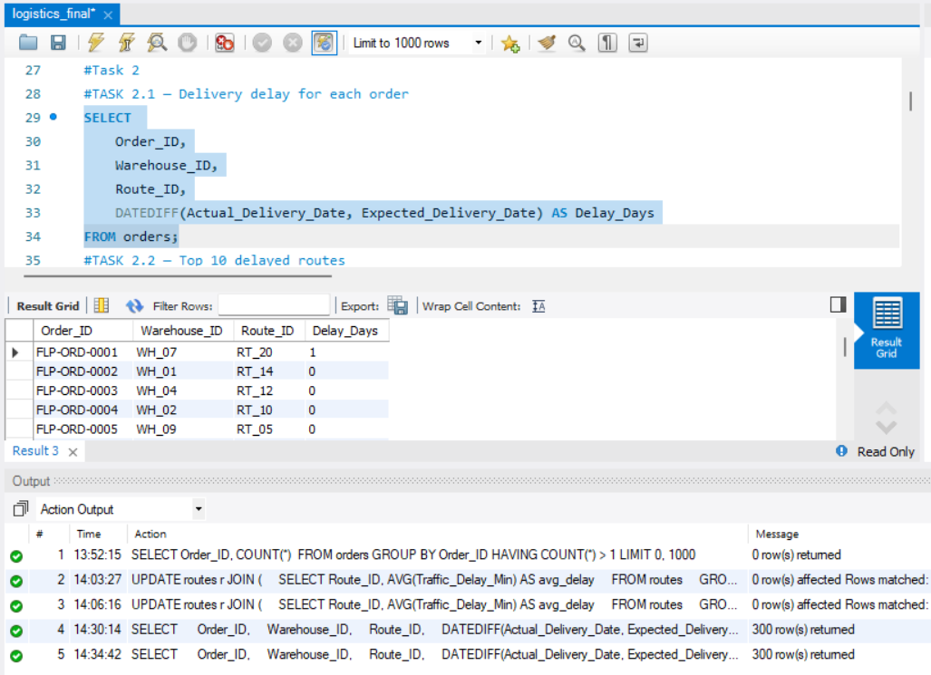
Task2:Delivery Delay Analysis:
Delivery Delay Calculation:
Delivery delay calculated using DATEDIFF function
Delay_Days = Actual_Delivery_Date - Expected_Delivery_Date
Interpretation:
Positive → Late delivery
Zero → On-time delivery
Negative → Early delivery
Key Steps:
Calculated delay for each order
Identified top 10 delayed routes
Analyzed delivery performance
Insight:
Certain routes show higher delays indicating inefficiencies

Slide 6
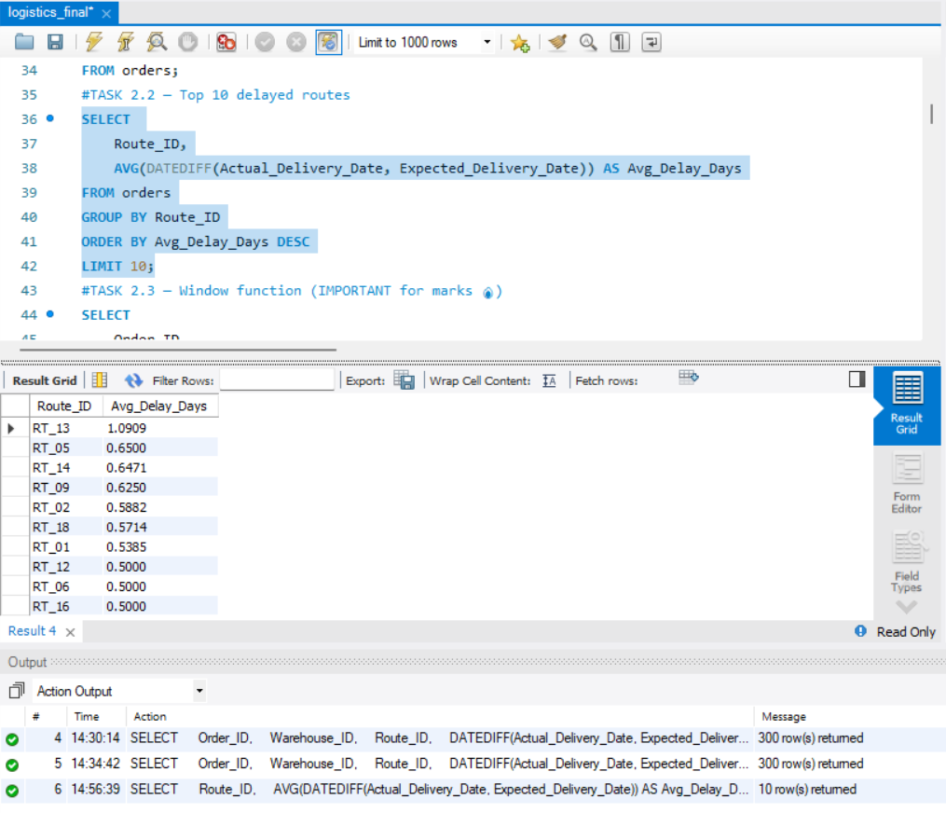
Top 10 Delayed Routes:
Analysis:
Delivery delay is calculated using the difference between Actual and Expected delivery dates.
Key Steps:
•Calculated delay using DATEDIFF
•Identified top 10 delayed routes
•Analyzed delivery performance across routes
Insight:
Certain routes show consistently higher delays, indicating inefficiencies in delivery operations.
Impact:
This analysis helps identify problematic routes and improve delivery planning.

Slide 7
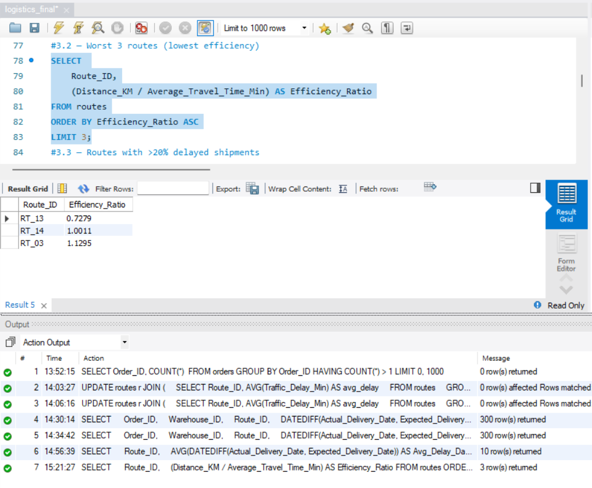
Task 3:Route Optimization insights.
Route performance Analysis:
Key Findings & Insights:
Calculated average delivery time, traffic delay, and efficiency ratio
Identified 3 routes with worst efficiency
Found routes with >20% delays
Inefficient routes require optimization
Improved route planning can reduce delays

Slide 8
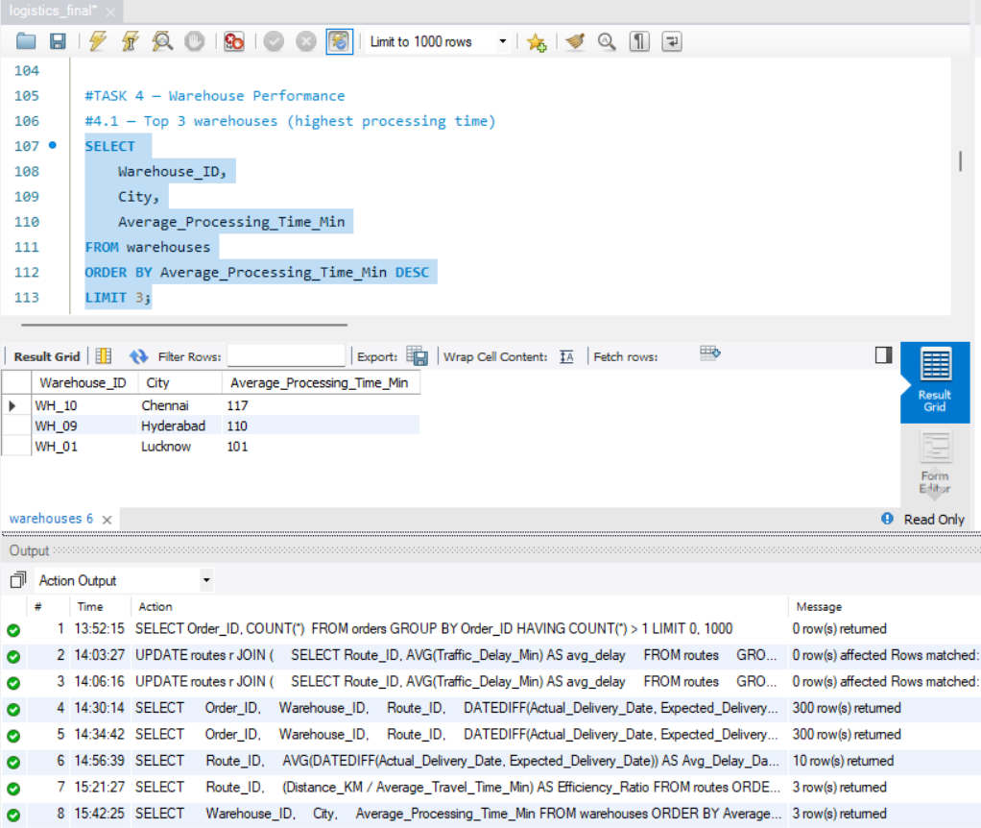
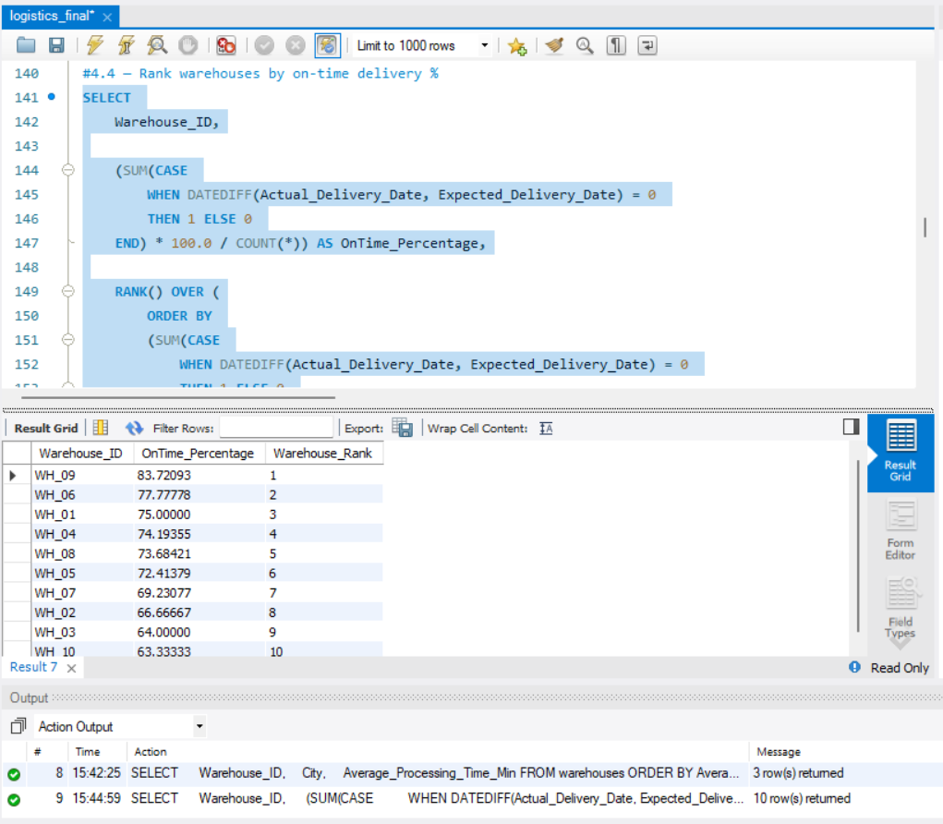
Task 4:Warehouse performance.
Warehouse performance analysis:
Top 3 warehouses:
Key findings & insights:
• Identified top 3 warehouses with highest processing time
• Compared total and delayed shipments for each warehouse
• Detected bottleneck warehouses using global average processing time
• Ranked warehouses based on on-time delivery percentage
• Poor performing warehouses require process improvement
Warehouses Ranking:

Slide 9
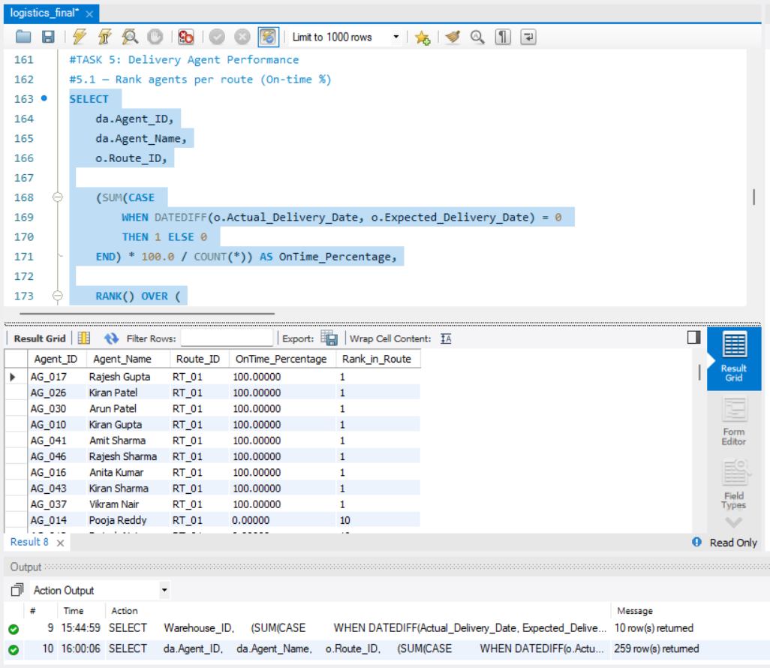
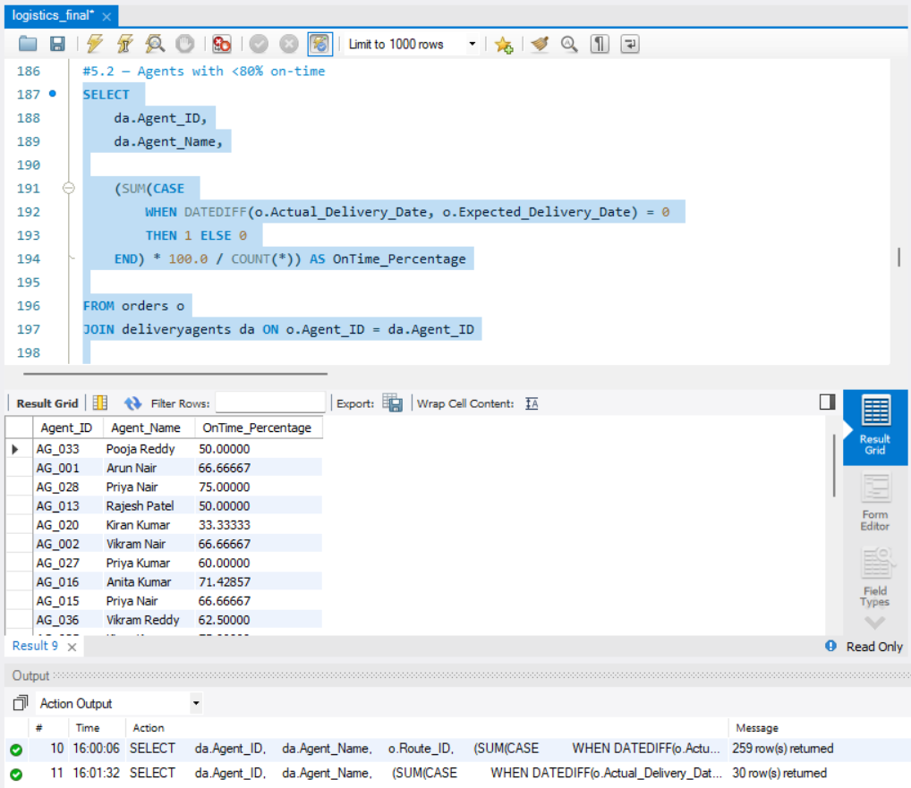
Task 5:Delivery Agent Performance.
Agent performance analysis
1.Agent Ranking.
Key findings and insights:
• Ranked agents based on on-time delivery percentage for each route
• Identified agents with less than 80% on-time performance
• Compared average speed of top 5 and bottom 5 agents
• Low-performing agents require training and workload balancing
• High-performing agents can be assigned critical delivery routes
2.Agent<80%.
Improvement Required:
Improving agent performance can significantly enhance overall delivery efficiency.

Slide 10
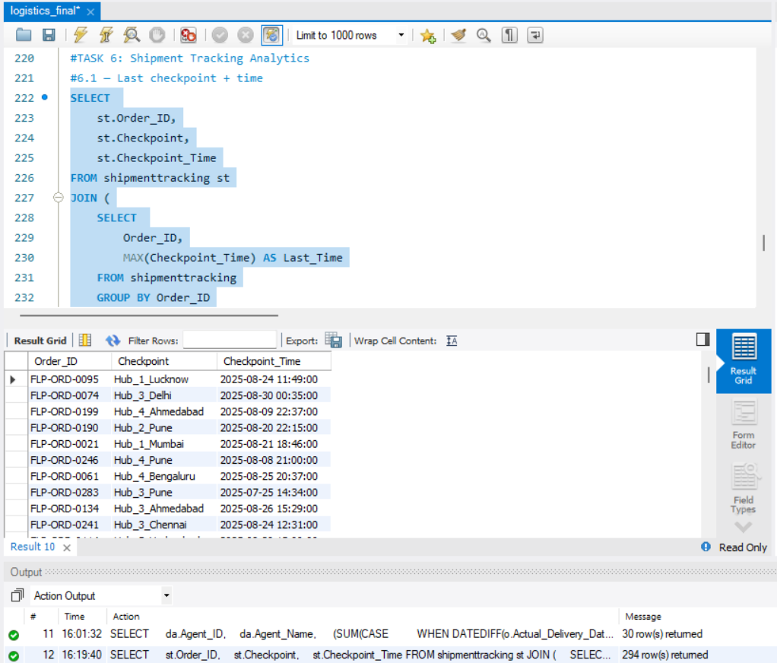
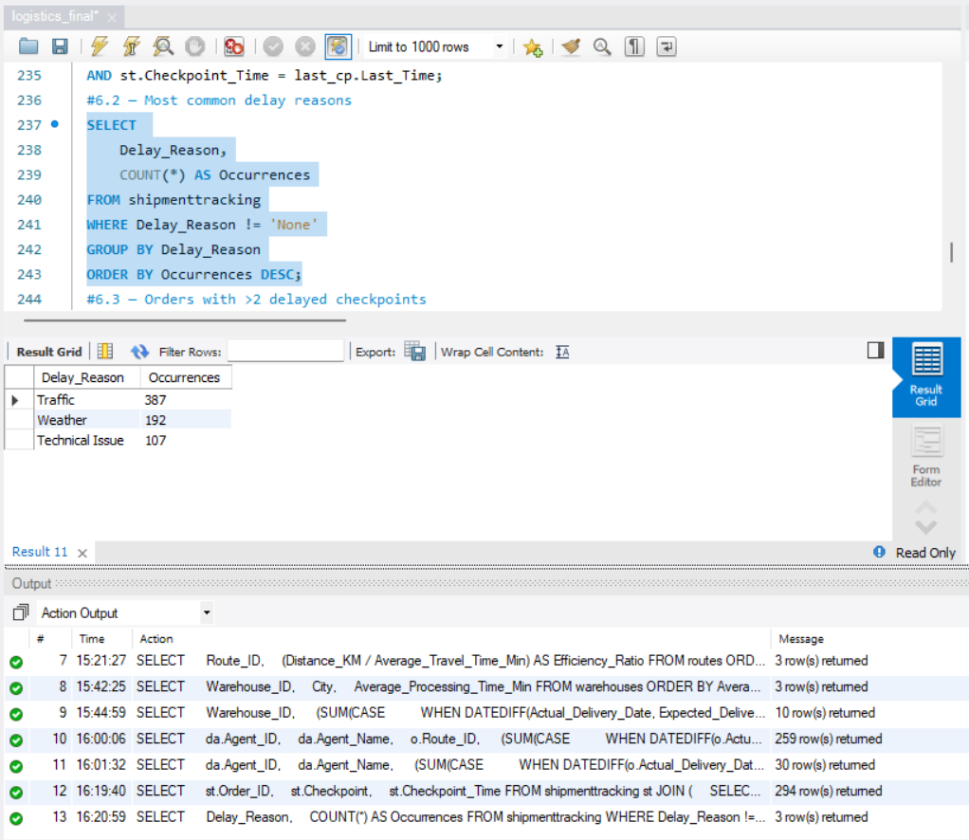
Task 6:Shipment Tracking Analytics.
Shipment Tracking Results:
1.Last checkpoint + time.
Key findings & insights:
• Retrieved the last checkpoint and corresponding time for each order
• Identified the most common delay reasons excluding 'None'
• Delay reasons such as traffic and operational issues were observed frequently
• Tracking checkpoints helps identify delays and improve delivery efficiency
2.Delay Reasons.
Impact:
Understanding delay patterns helps optimize shipment tracking and reduce delays.

Slide 11
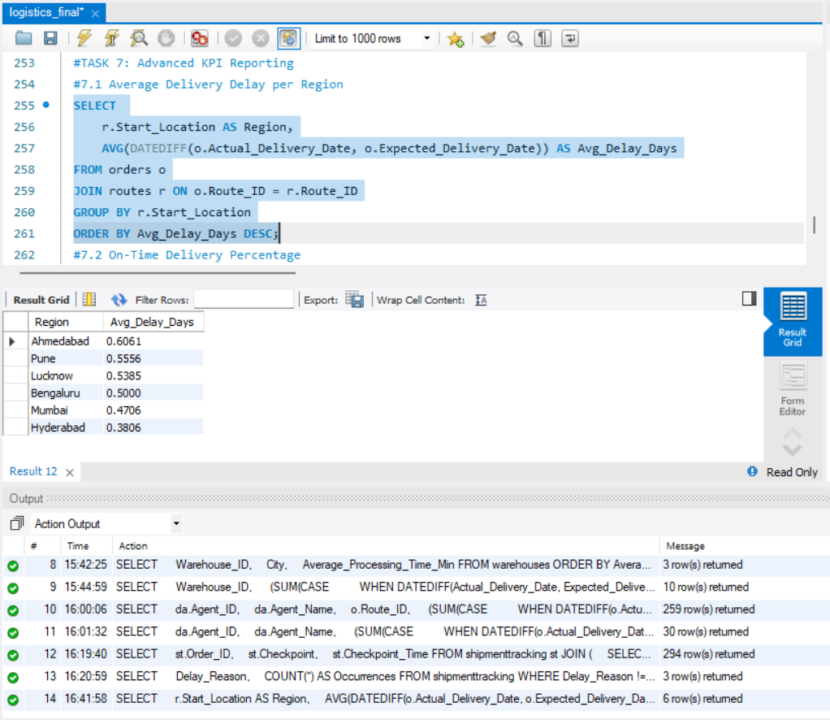
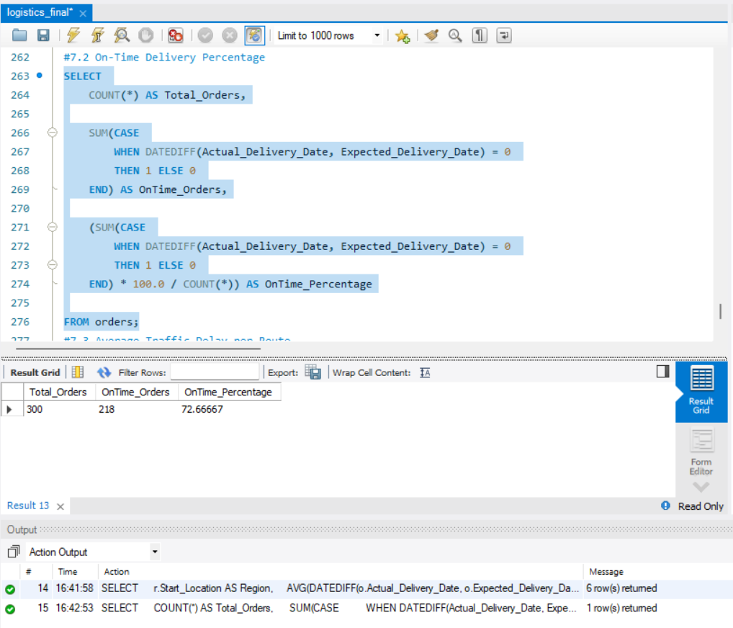
Task 7:Advanced KPI Reporting.
KPI Results:
1.Average delay per region.
Key metrics & insights:
• Calculated average delivery delay across different regions
• Computed overall on-time delivery percentage
• Identified variations in delivery performance across regions
• On-time delivery rate reflects overall efficiency of logistics system
• KPI analysis helps in improving delivery performance and planning
2.on-time delivery%.

Slide 12
Conclusion
• Data cleaning ensured accuracy and reliability of the dataset
• Key factors causing delivery delays were identified
• Inefficient routes and bottleneck warehouses were detected
• Agent performance and shipment tracking issues were analyzed
• KPI analysis provided clear insights into overall logistics performance
• Suggested improvements can optimize delivery operations and reduce delays
• SQL-based analysis enables better decision-making in logistics management

Slide 13
Project Video Link:
Ctrl + Click on link to watch video
https://drive.google.com/file/d/1God0TMB_ol6FVlljtoHs-BJnU4Aeg-9Z/view?usp=sharing

